Slide 1

A workshop on Python Programming and Artificial Intelligence for Teachers

Slide 2

There is so much Interest in Artificial Intelligence

Slide 3


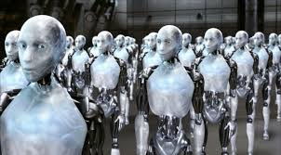
What is Artificial Intelligence?
This is what people think when they hear the term Artificial Intelligence

Slide 4
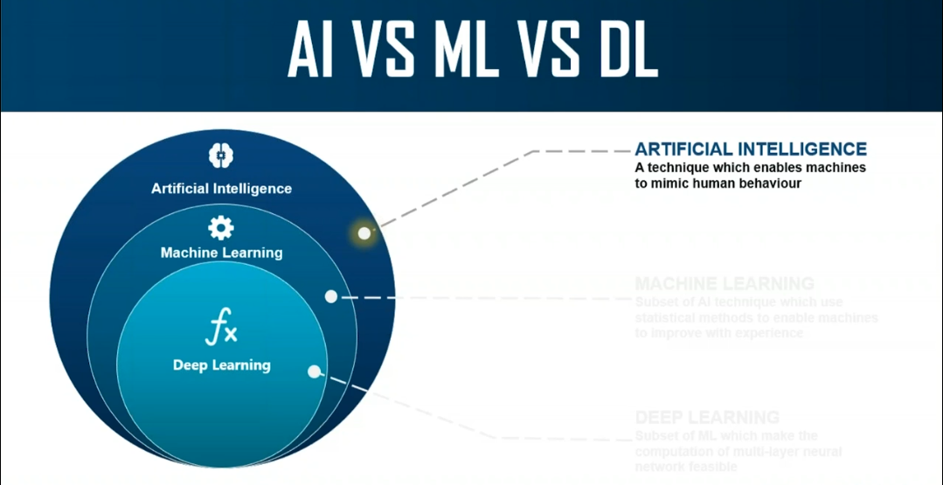
Clearing the Confusion

Slide 5
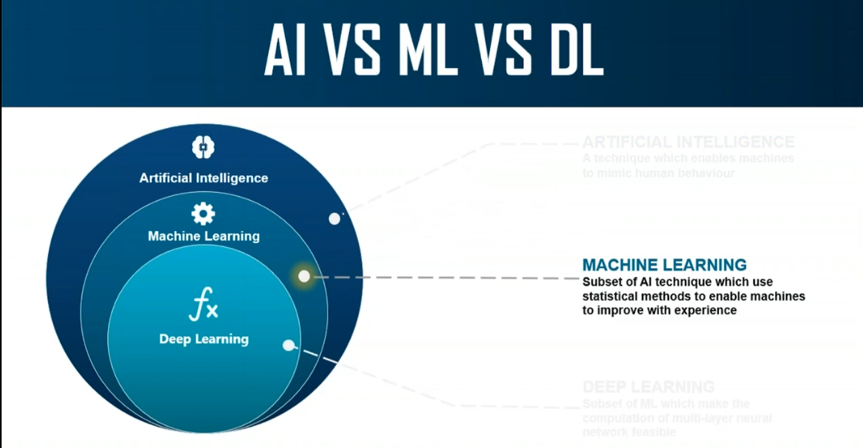
Clearing the Confusion

Slide 6
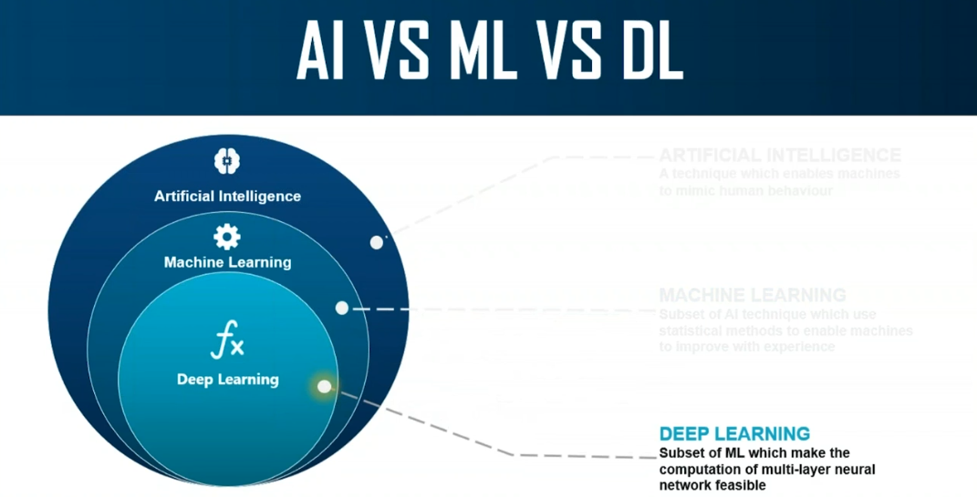
Clearing the Confusion

Slide 7
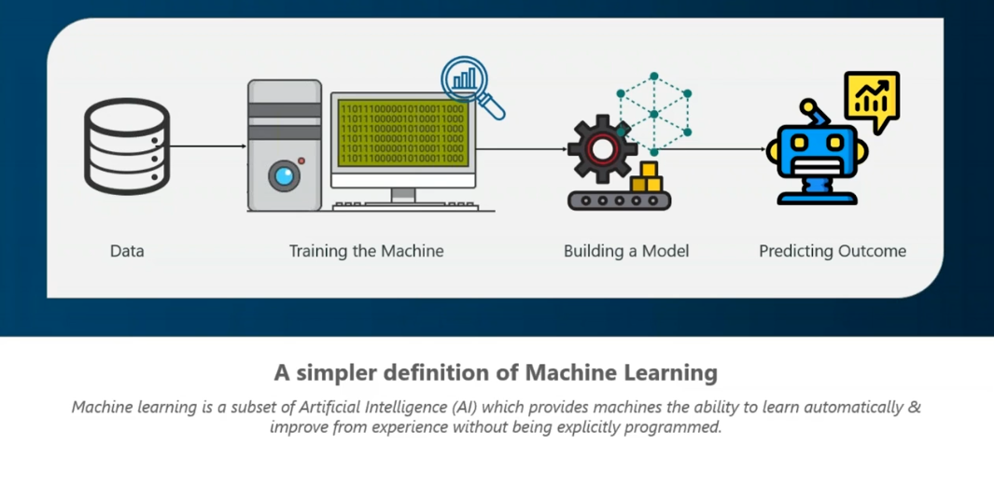
Machine Learning

Slide 8
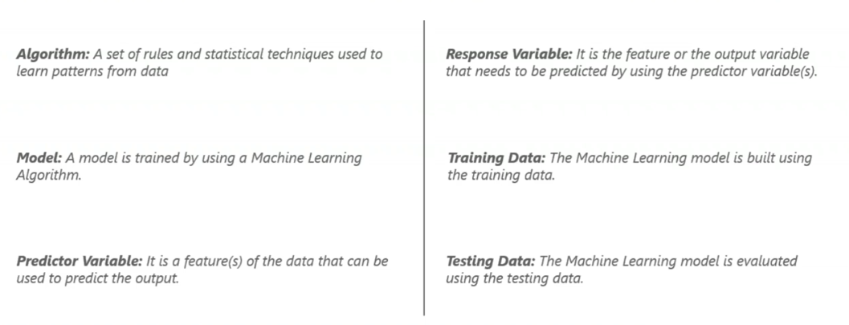
Machine Learning Definitions

Slide 9
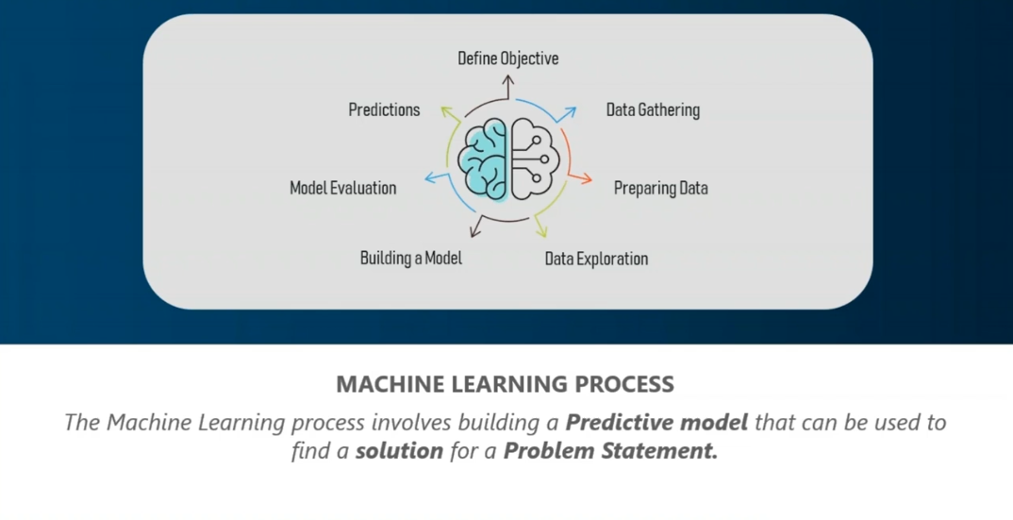
Machine Learning Process

Slide 10
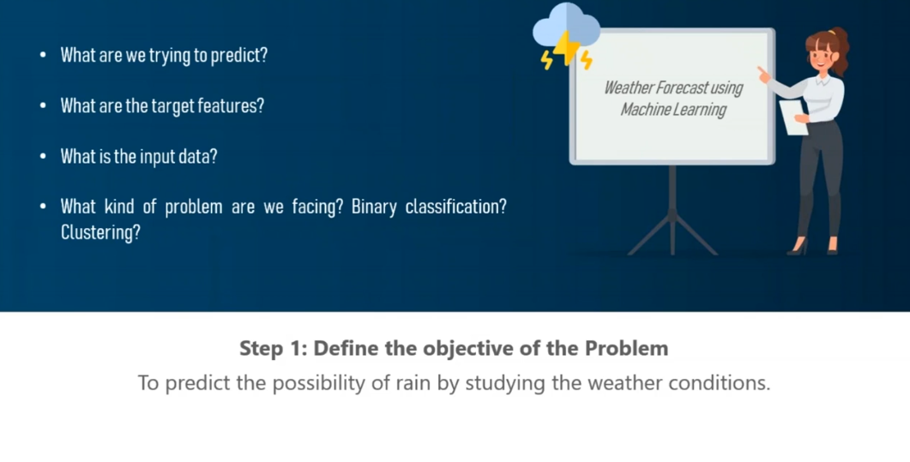
Machine Learning Process

Slide 11
Machine Learning Process

Slide 12
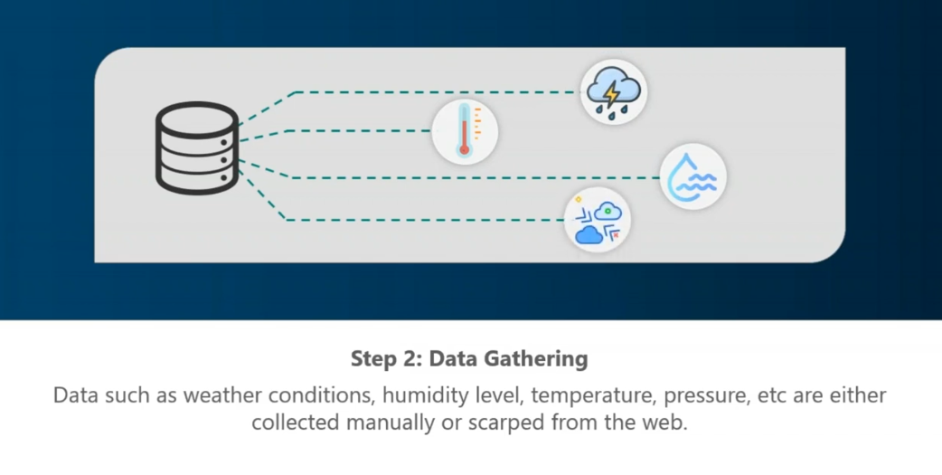
Machine Learning Process

Slide 13
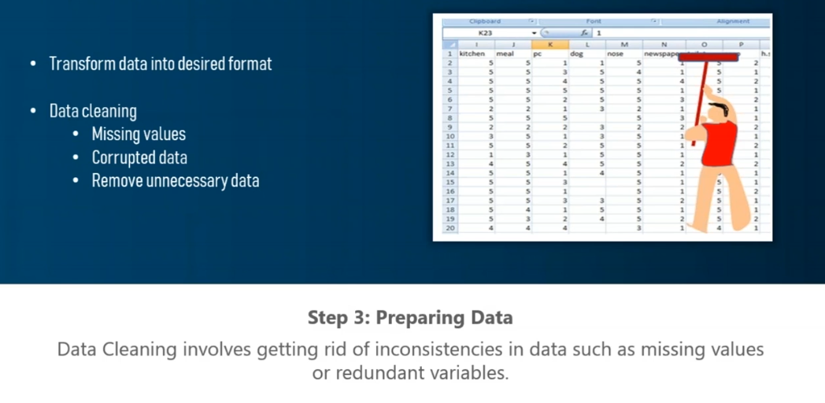
Machine Learning Process

Slide 14
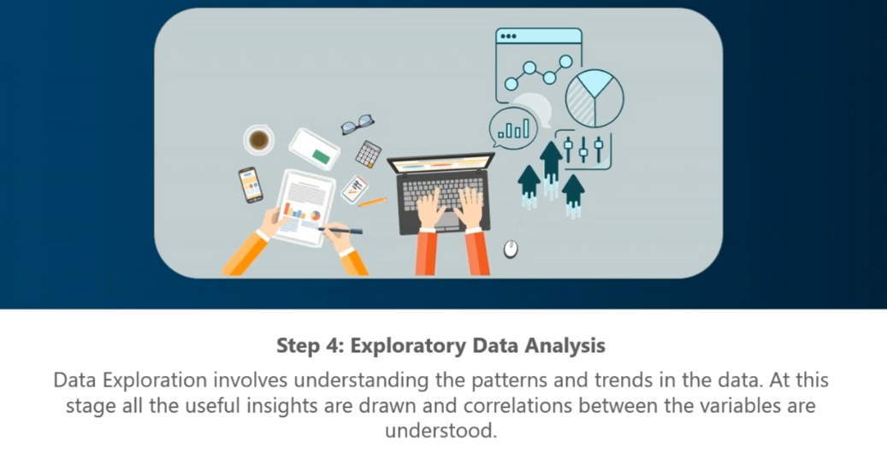
Machine Learning Process

Slide 15
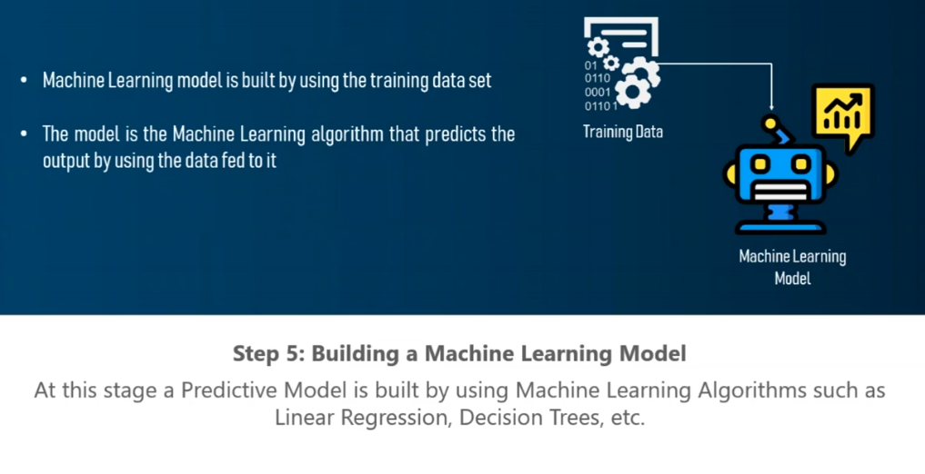
Machine Learning Process

Slide 16
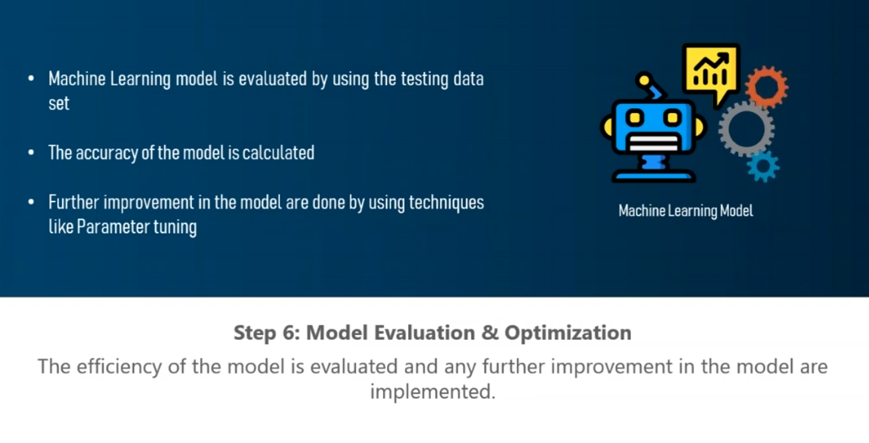
Machine Learning Process

Slide 17
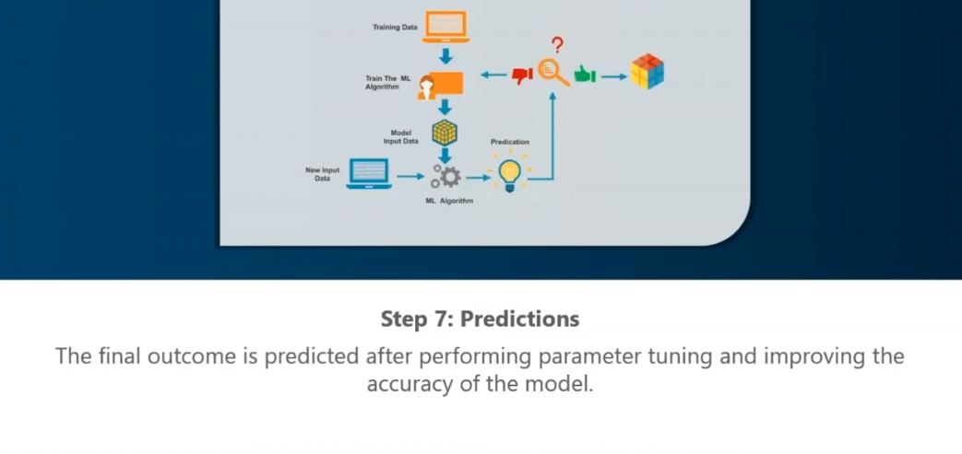
Machine Learning Process

Slide 18
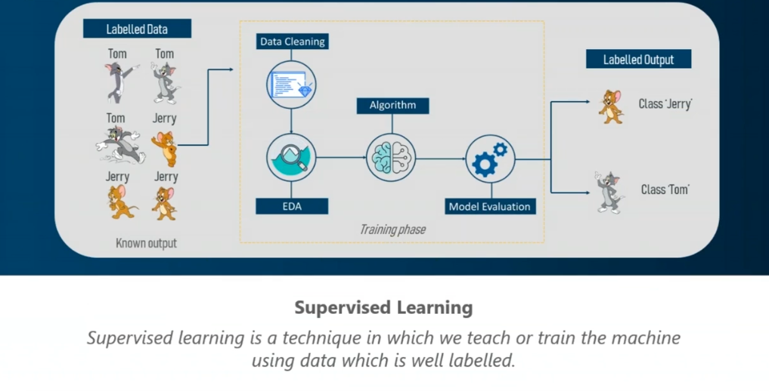
Types of Machine Learning

Slide 19
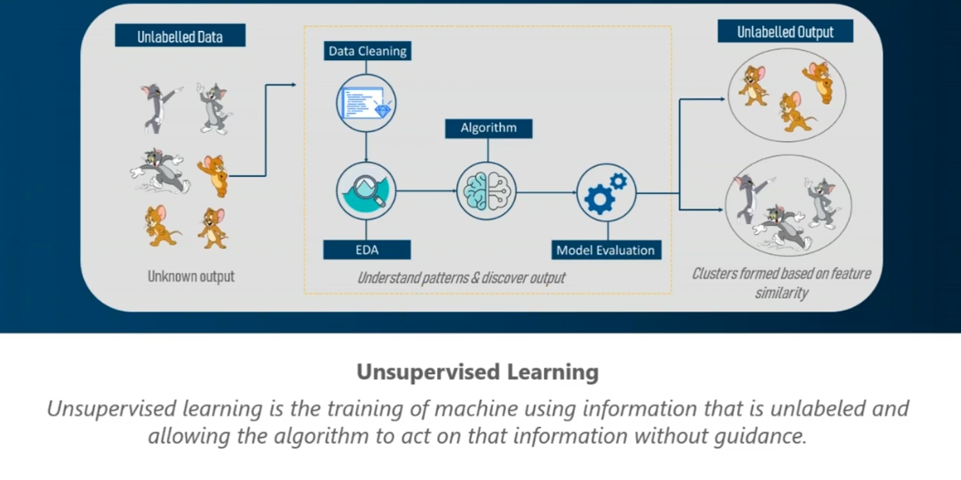
Types of Machine Learning

Slide 20
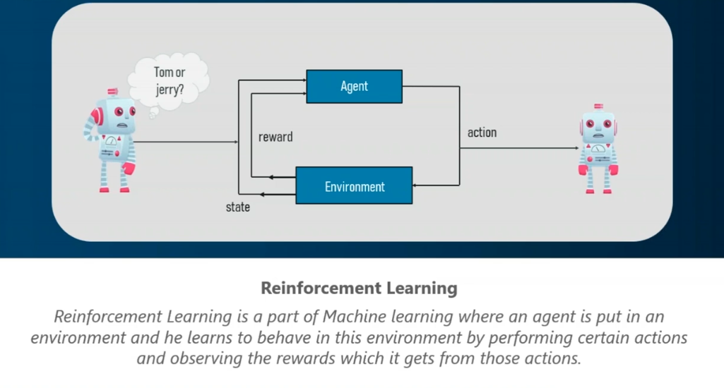
Types of Machine Learning

Slide 21
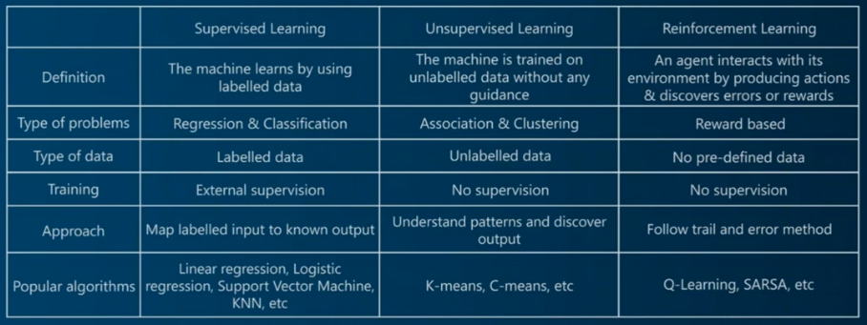
Types of Machine Learning

Slide 22
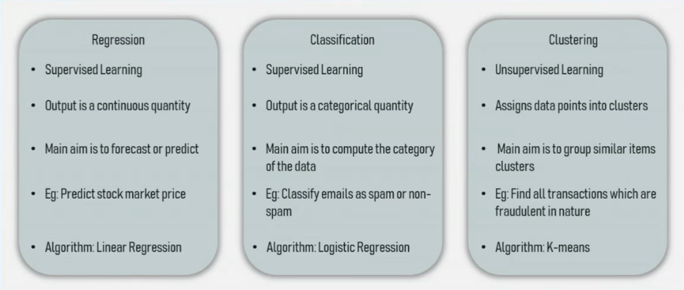
Classification of Problems solved by Machine Learning

Slide 23
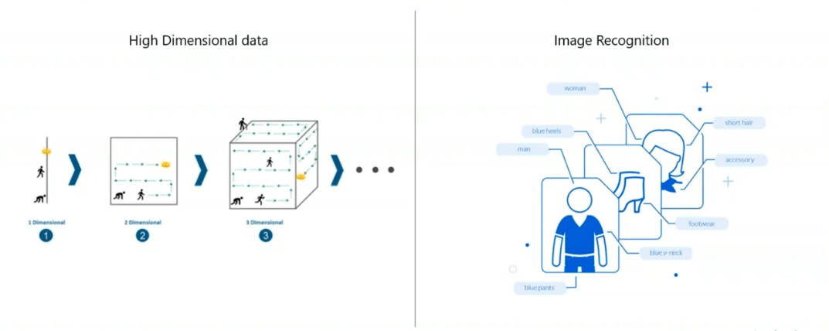
Limitations of Machine Learning
“Curse of Dimensionality”

Slide 24

Why Deep learning?
One of the big challenges with traditional Machine Learning model is a process called Feature extraction. For complex problems such as object recognition, this is a huge challenge.
Deep Learning models are capable of focussing on the right features themselves, requiring little guidance from the programmers

Slide 25
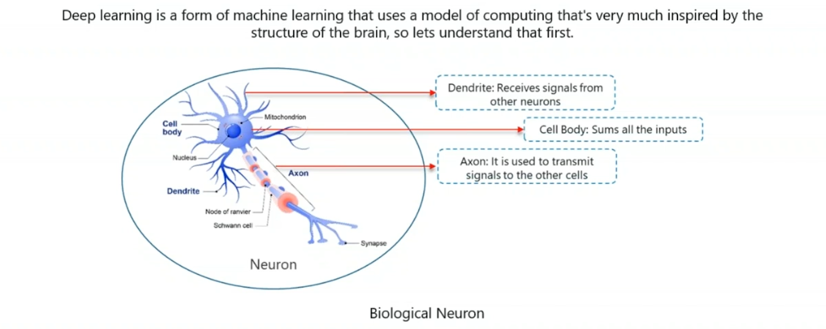
How Deep Learning works?

Slide 26
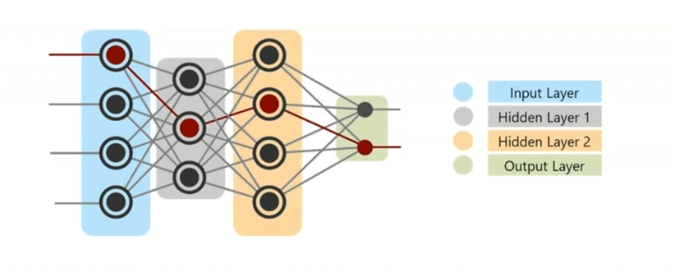
What is Deep Learning?
Deep learning is a class of machine learning algorithms that uses multiple layers to progressively extract higher level features from the raw input. For example, in image processing, lower layers may identify edges, while higher layers may identify the concepts relevant to a human such as digits or letters or faces.

Slide 27
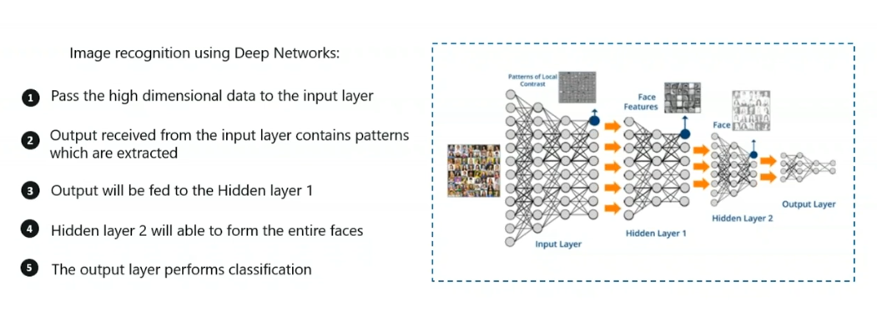
Understanding Deep Learning

Slide 28
Popular Application of Artificial Intelligence
Recommender Systems
Medical Diagnosis
Fraud Detection
Financial Services
Traffic Solutions

Slide 29
Popular Application of Artificial Intelligence
Recommender Systems
Medical Diagnosis
Fraud Detection
Financial Services
Traffic Solutions

Slide 30
Recommender Systems

Slide 31

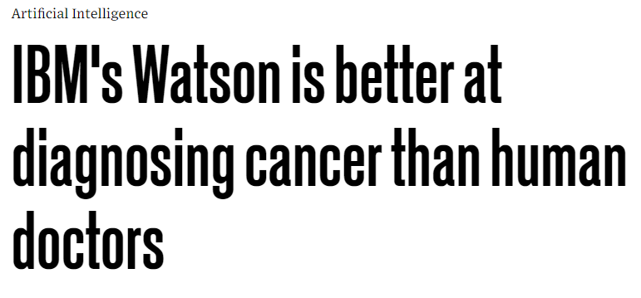
Medical Diagnosis

Slide 32
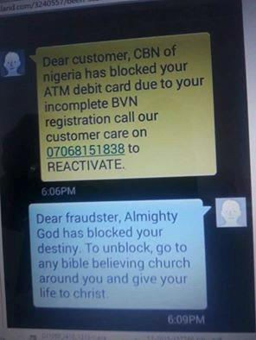
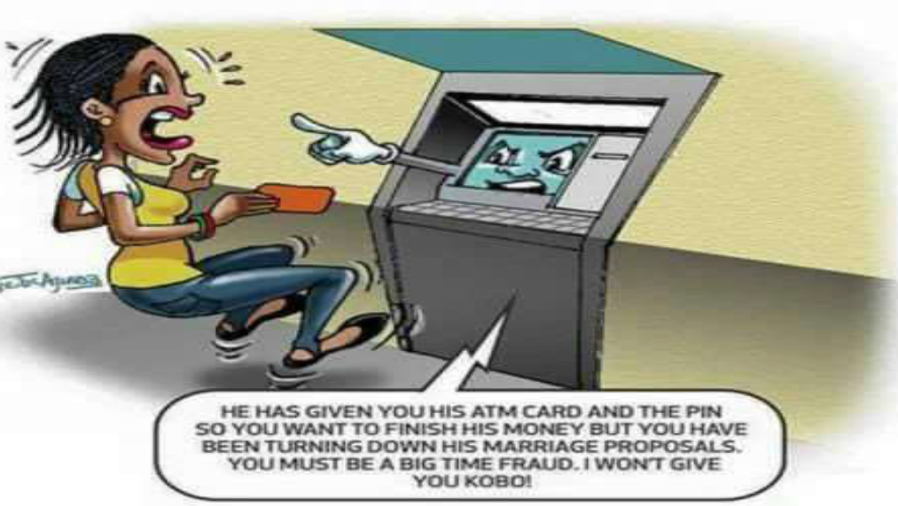
Fraud Detection

Slide 33

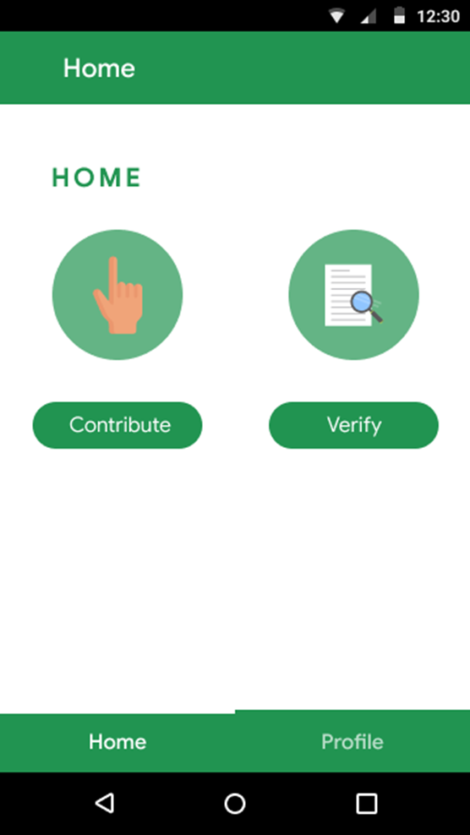
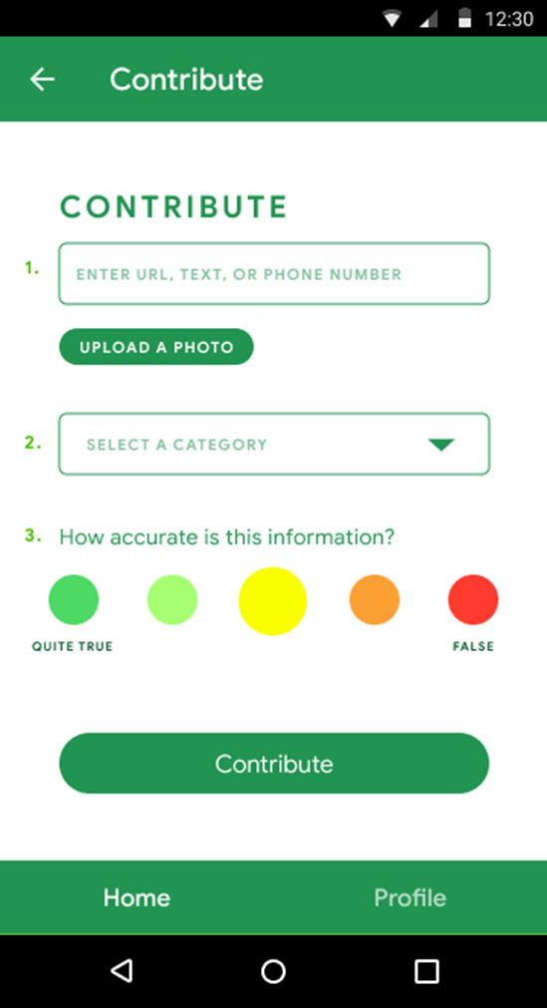
Fraud Detection: Na Lie by Data Science Nigeria

Slide 34

Financial Services

Slide 35
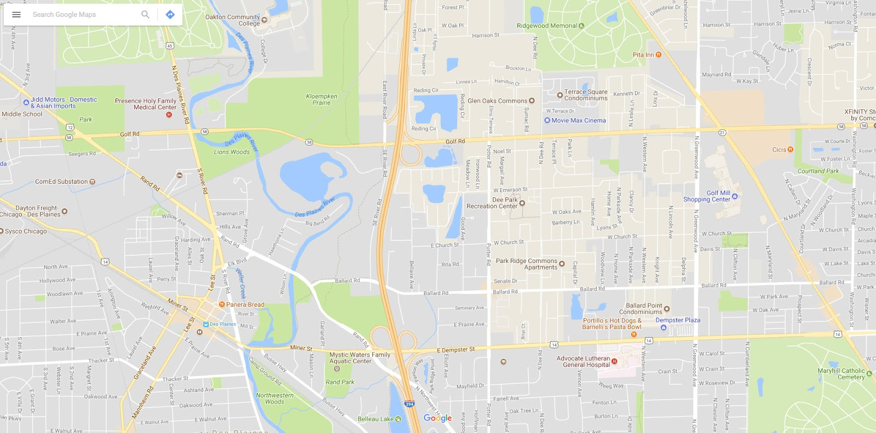
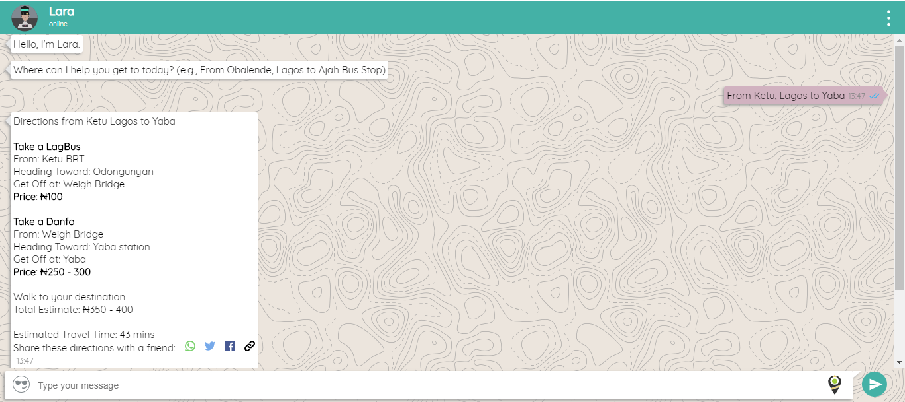
Traffic Solution

Slide 36

Website: www.datasciencenigeria.org
Email: info@datasciencenigeria.org
Twitter: Datasciencenig
Instagram: Datasciencenigeria
Facebook: facebook.com/datasciencenig
YouTube: https://goo.gl/Vcjjyp
Phone : +2348140000853
For videos and other reports, you can see a link to 25 key milestones of the non-profit via this link https://goo.gl/Hc5Bhd

